Slide 1
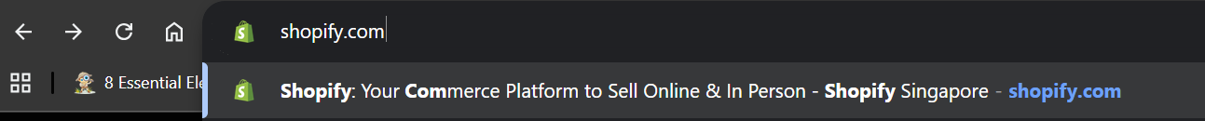
Step 1: Go to Shopify.com

Slide 2
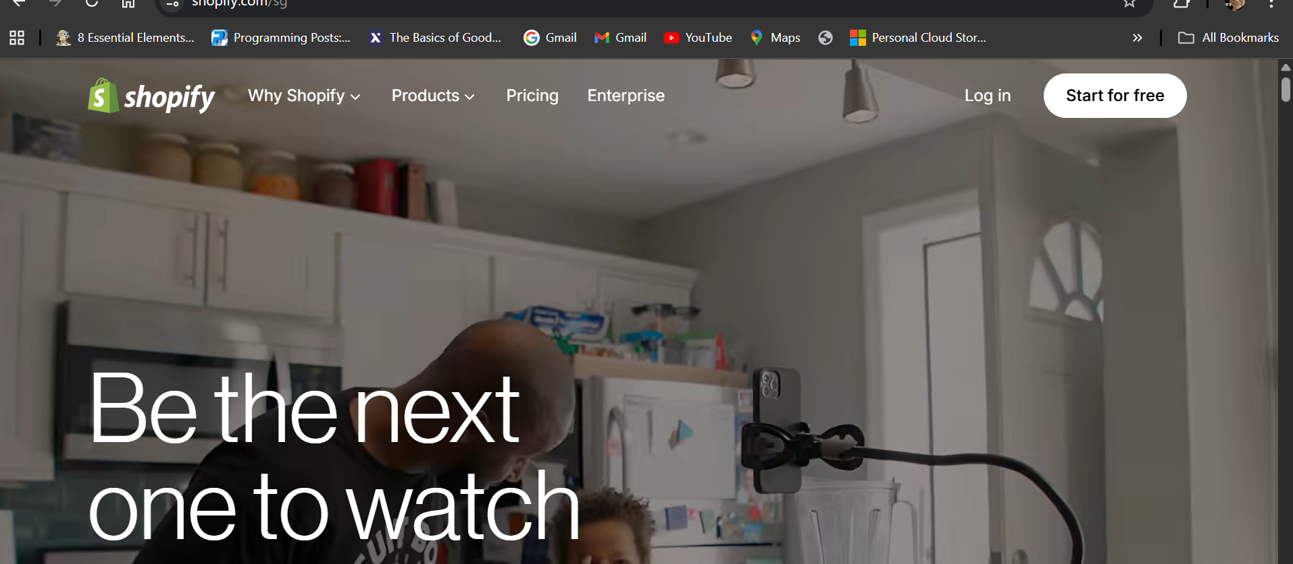
Step 2: Click “Start for Free”

Slide 3
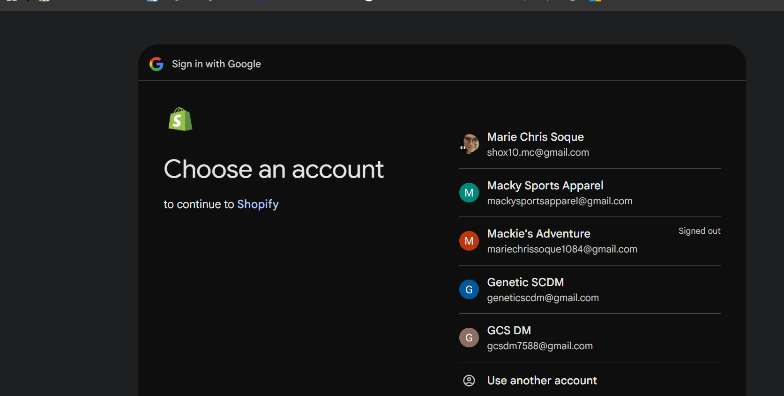
Step 3: Select the gmail account from which you want to tie your Shopify Account set-up
Note: The gmail account is this step is only an example.

Slide 4
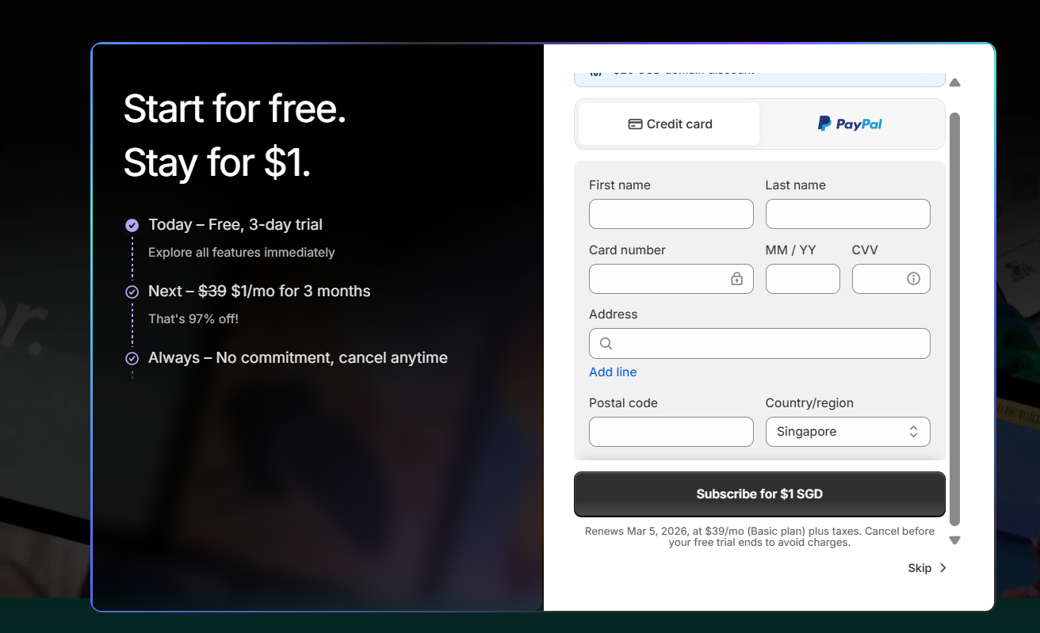
Step 4: Click “Skip”
Note: The trial period of a Shopify account is only 3 days. So, if more than 3 days, you need to pay $1/month for the next 3 months. If not cancelled after 3 months, the subsequent months will be charged with $39

Slide 5
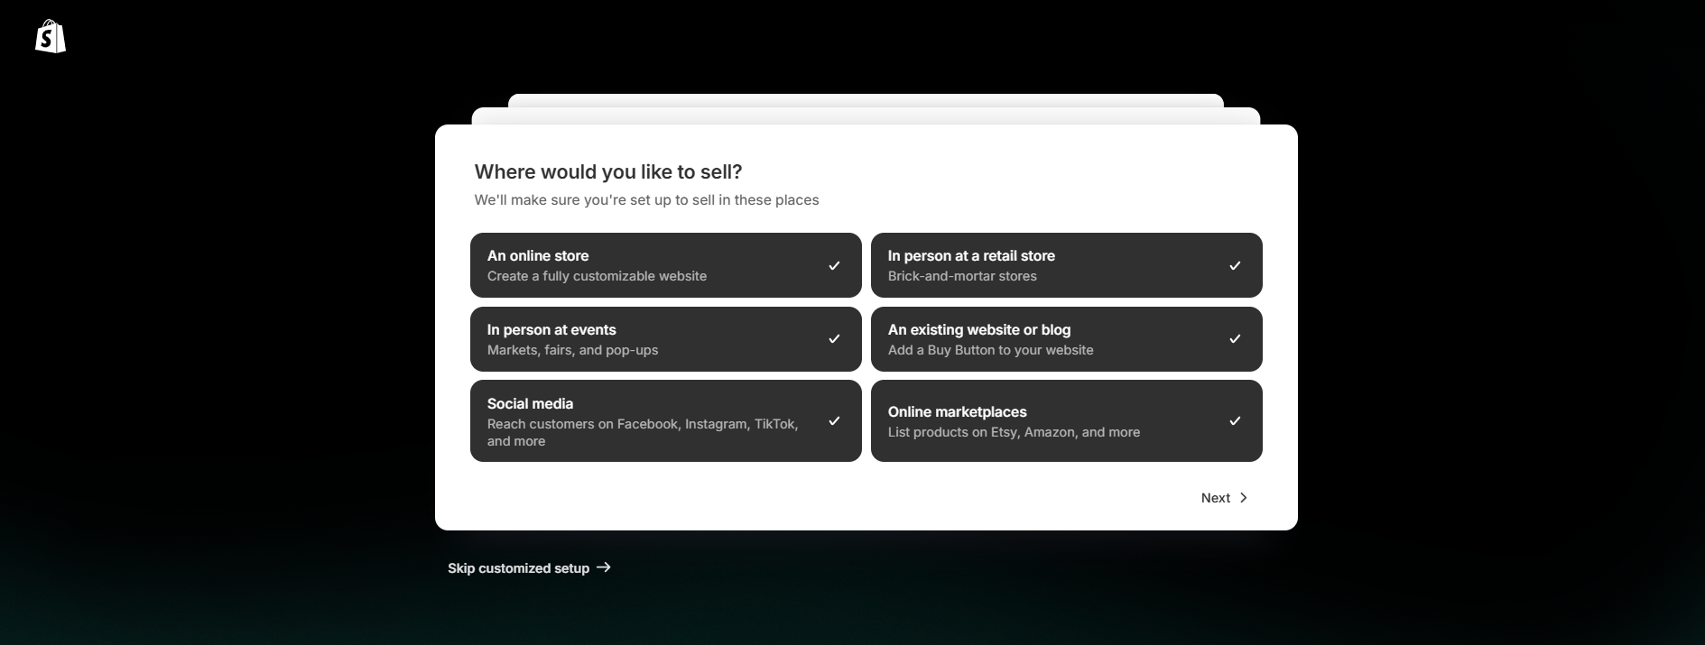
Step 5: Select all, so that all these features will be included in your Shopify Dashboard features. Click “Next” for the next step

Slide 6
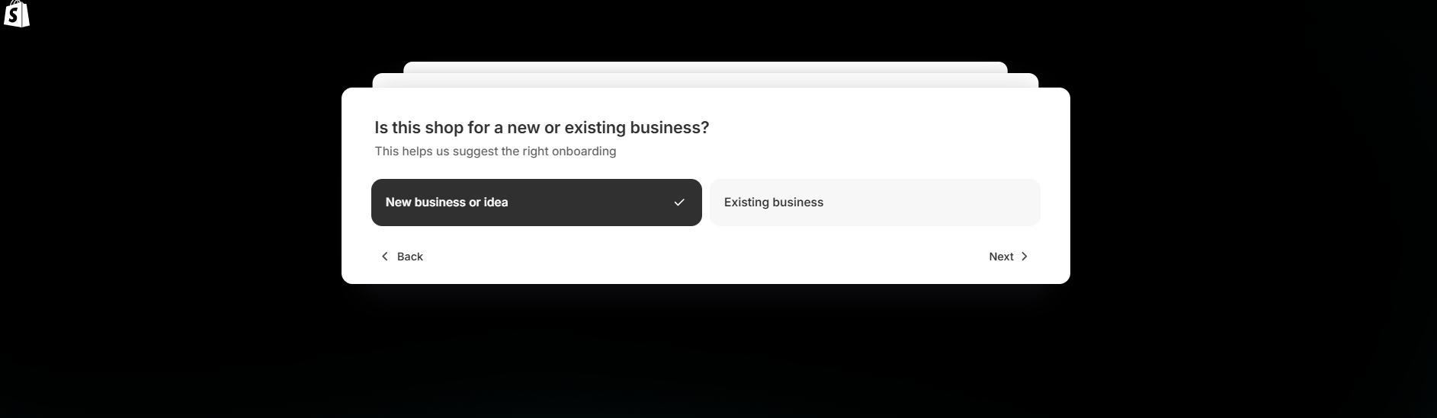
Step 6: Select “New business or idea”. Click “Next” for the next step
Note: Since, this is the first to set-up the Shopify account then it is advised to use the “New business or idea” unless otherwise the
E-commerce website is for an existing/real business.

Slide 7
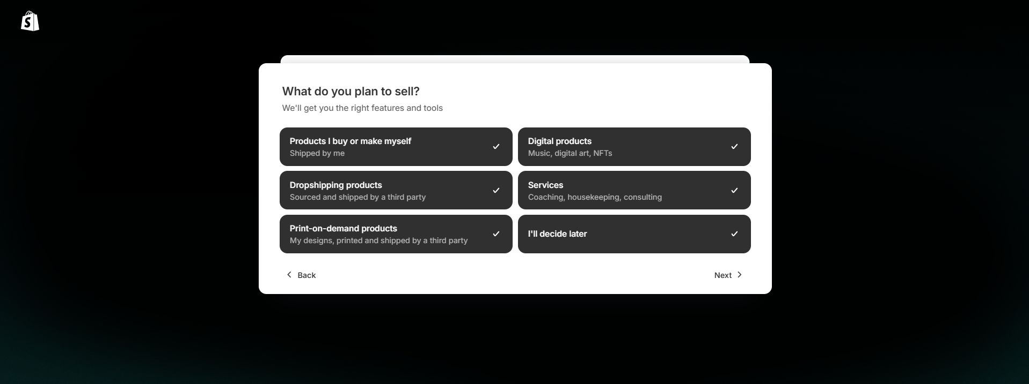
Step 7: Select “All” as of now, for the set features to be loaded in the Shopify Dashboard. Click “Next” for the next step
Note: This can be custom, depending on what type of products the E-commerce website will sell.

Slide 8
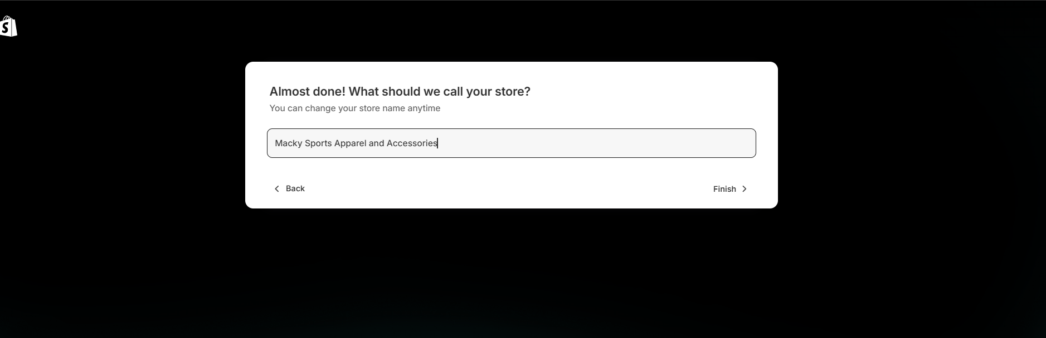
Step 8: Name the Store accordingly. Click “Finish” to complete the set up of the Shopify store.

Slide 9
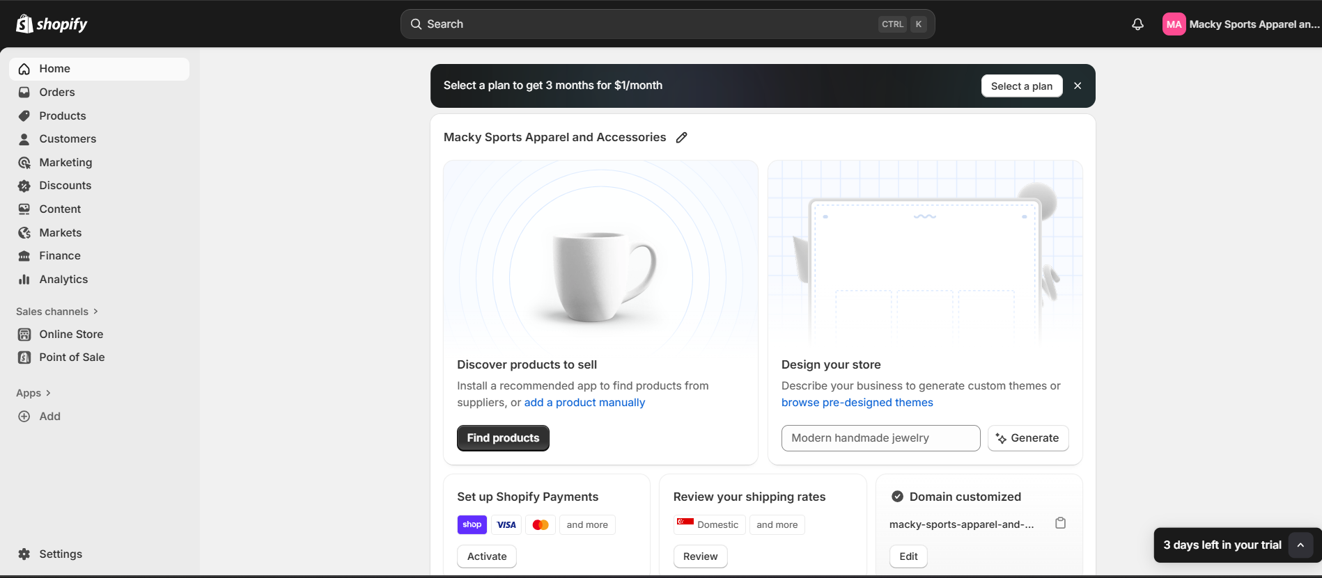
This will be the Shopify Dashboard after following Steps 1 to Step 8.

